Slide 1

Apex Institute of Technology
Department of Computer Science & Engineering
Computer Organization & Architecture
(CST-281)
Jayashree Mohanty
E15737
Assistant Professor
CSE(AIT), CU
DISCOVER . LEARN . EMPOWER

Slide 2
About Course
This course is introduced to 4th semester students of BE
This course offers a good understanding of the various functional units of a computer system and prepares the students to be in a position to design a basic computer system
In addition to this students will be exposed to the recent trends in parallel and distributed computing and multithreaded application

Slide 3
In This Lecture
Why are arithmetic circuits so important
Adders
Adding two binary numbers
Adding more than two binary numbers
Circuits Based on Adders
Multipliers
Functions that do not use adders
Arithmetic Logic Units

Slide 4
Motivation: Arithmetic Circuits
Core of every digital circuit
Everything else is side-dish, arithmetic circuits are the heart of the digital
system
Determines the performance of the system
Dictates clock rate, speed, area
If arithmetic circuits are optimized performance will improve
Opportunities for improvement
Novel algorithms require novel combinations of arithmetic circuits, there is always room for improvement

Slide 5
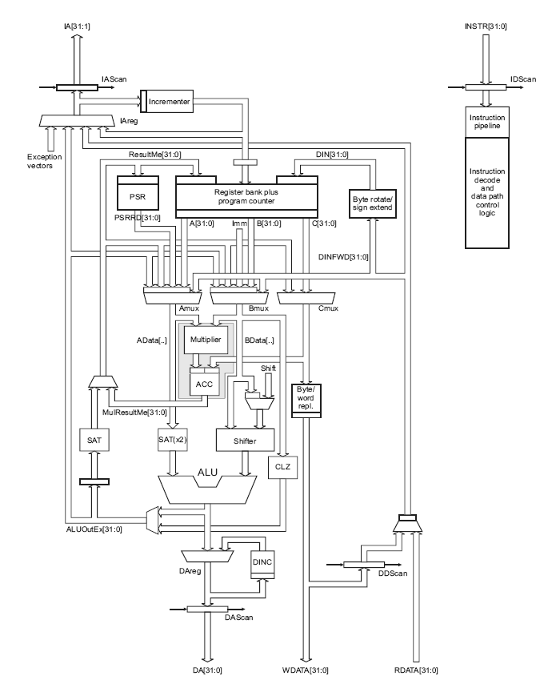
Example: ARM Microcontroller
Most popular embedded micro controller.
Contains:
Multiplier
Accumulator
ALU/Adder
Shifter
Incrementer

Slide 6
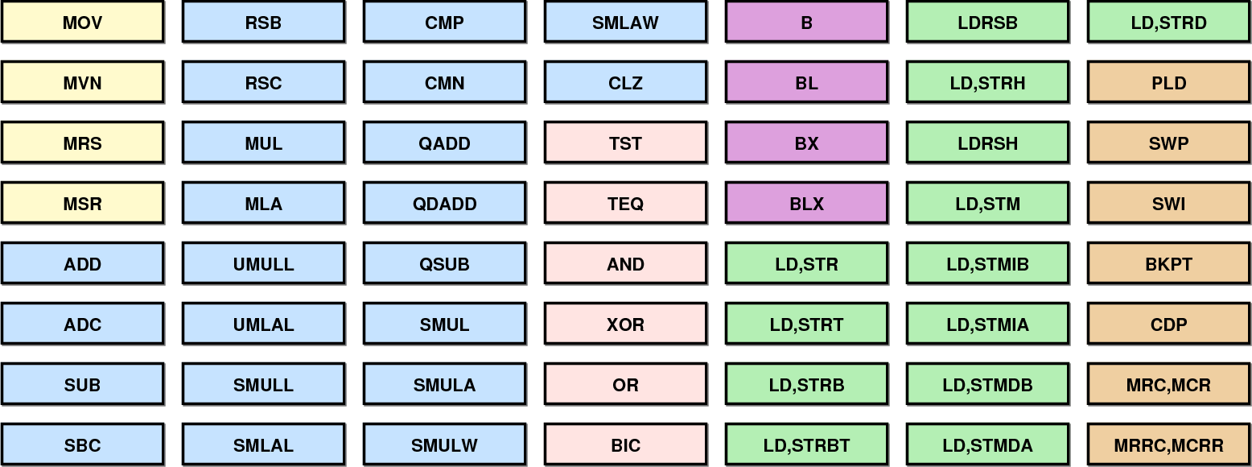
Example: ARM Instructions

Slide 7
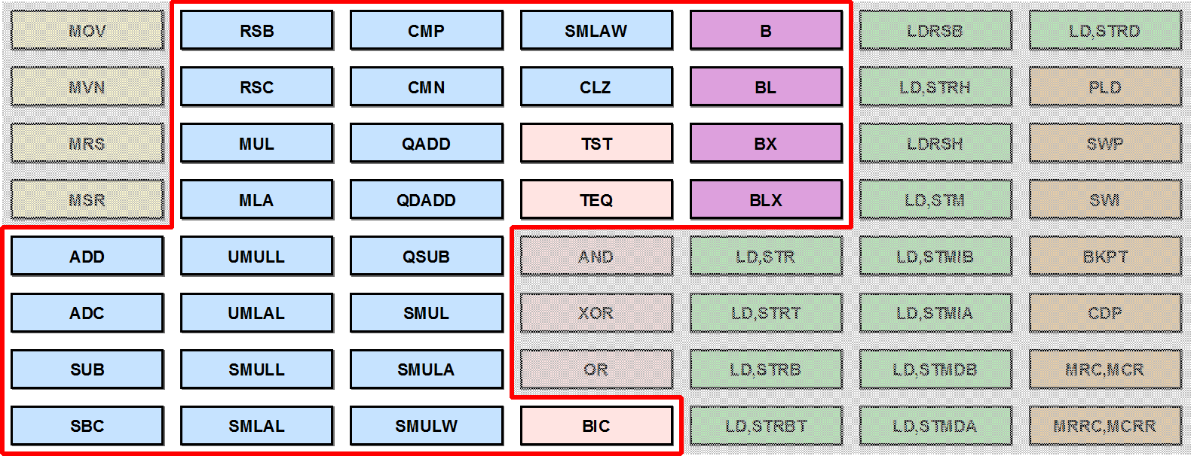
Arithmetic Based Instructions of ARM

Slide 8
Types of Arithmetic Circuits
In order of complexity:
Shift / Rotate
Compare
Increment / Decrement
Negation
Addition / Subtraction
Multiplication
Division
Square Root
Exponentation
Logarithmic / Trigonometric Functions

Slide 9
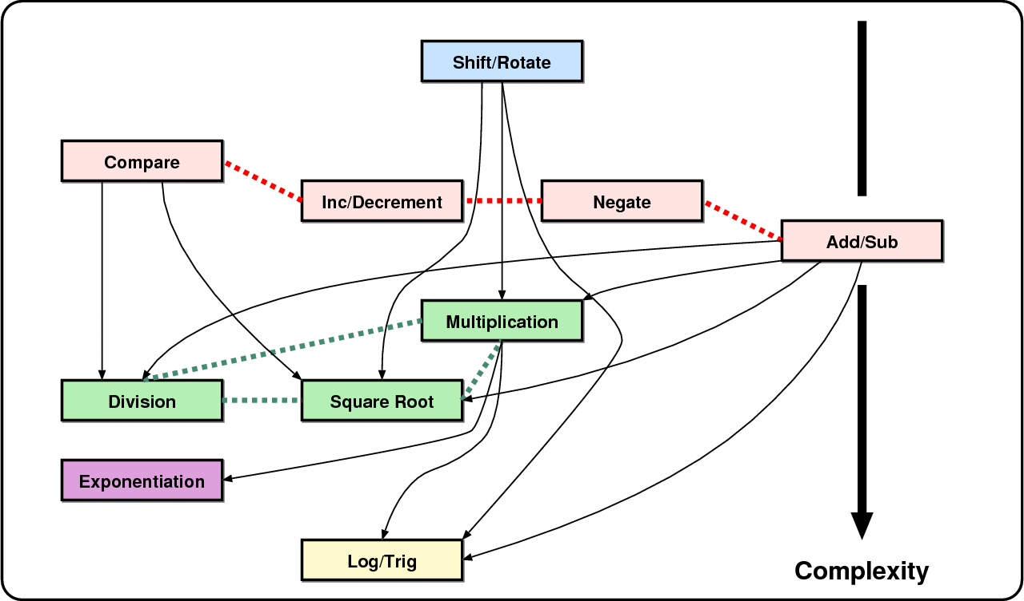
Relation Between Arithmetic Operators

Slide 10
Addition
Addition is the most important operation in computer arithmetic. Our topics will be:
Adding 1-bit numbers : Counting bits
Adding two numbers : Basics of addition
Circuits based on adders : Subtractors, Comparators
Adding multiple numbers : Chains of Adders
Later we will also talk about fast adder architectures

Slide 11
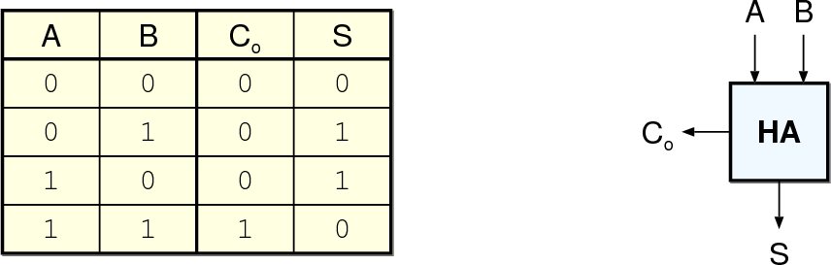
Half-Adder (2,2) Counter
The Half Adder (HA) is the simplest arithmetic block
It can add two 1-bit numbers, result is a 2-bit number
Can be realized easily

Slide 12
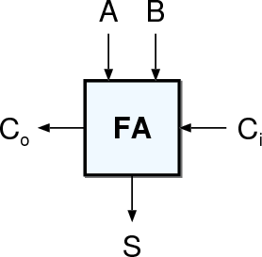
Full-Adder (3,2) Counter
The Full Adder (FA) is the essential
arithmetic block
It can add three 1-bit numbers, result is a 2-bit number
There are many realizations both at
gate and transistor level.
Since it is used in building many arithmetic operations, the performance of one FA influences the overall performance greatly.

Slide 13
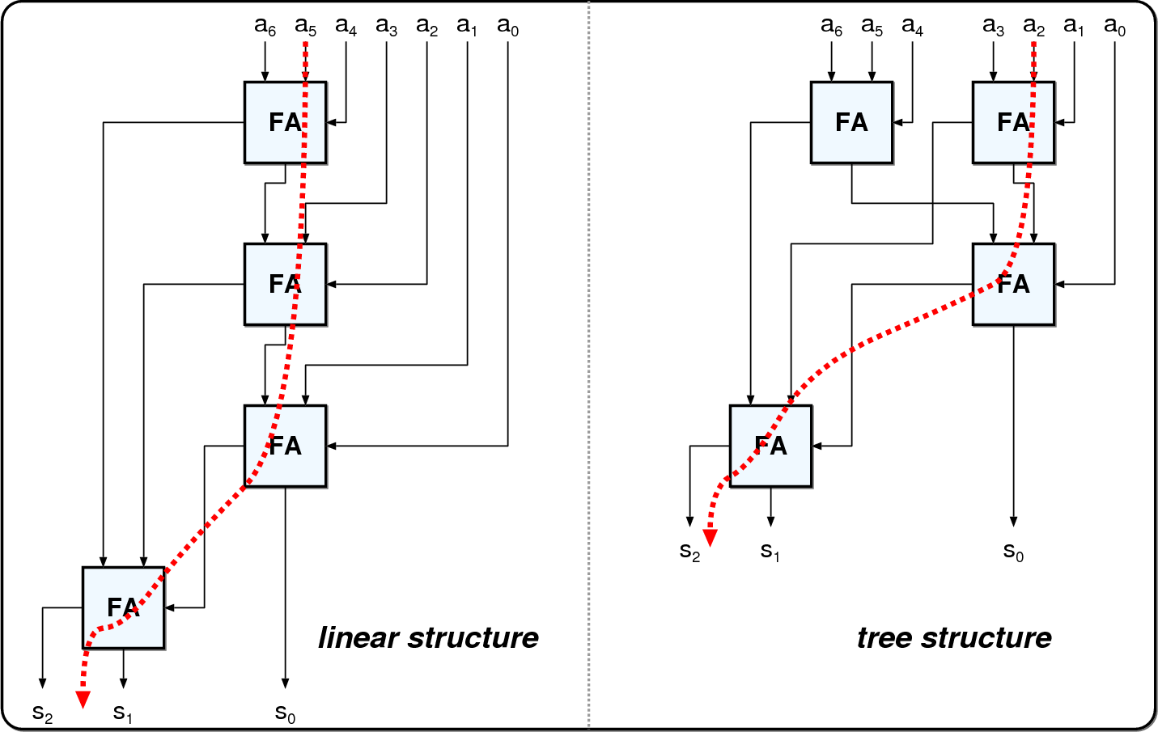
Adding Multiple 1-bit Numbers

Slide 14
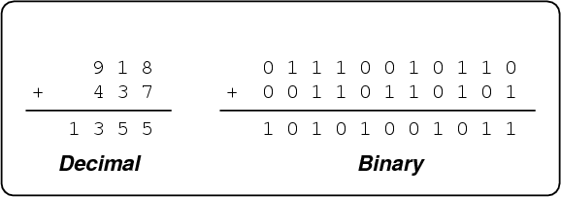
Adding Multiple Digits
Similar to decimal addition
Starting from the right, each digit is added
The carry from one digit is added to the digit to the left

Slide 15
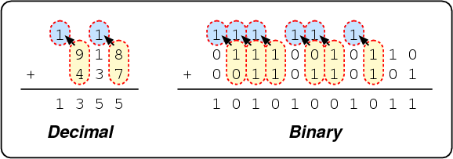
Adding Multiple Digits
Similar to decimal addition
Starting from the right, each digit is added
The carry from one digit is added to the digit to the left

Slide 16
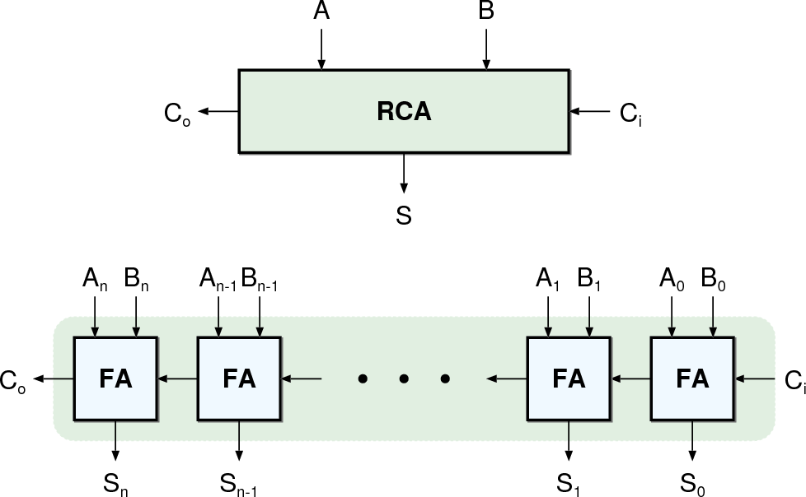
Ripple Carry Adder (RCA)

Slide 17
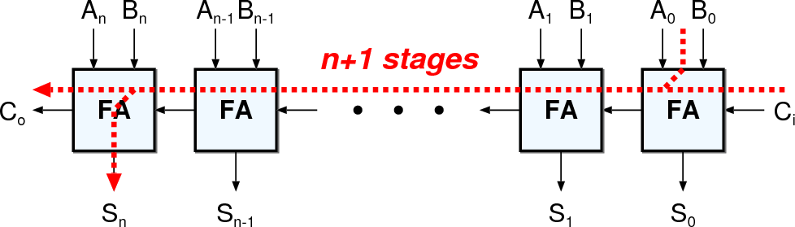
Curse of the Carry
The most significant outputs of the adder depends on the least significant inputs

Slide 18
Adding Multiple Numbers
Multiple fast adders not a good idea
If more than 2 numbers are to be added, multiple fast adders are not
really efficient
Use an array of ripple carry adders
Popular and efficient solution
Use carry save adder trees
Instead of using carry propagate adders (the adders we have seen so far), carry save adders are used to reduce multiple inputs to two, and then a single carry propagate adder is used to sum up.

Slide 19
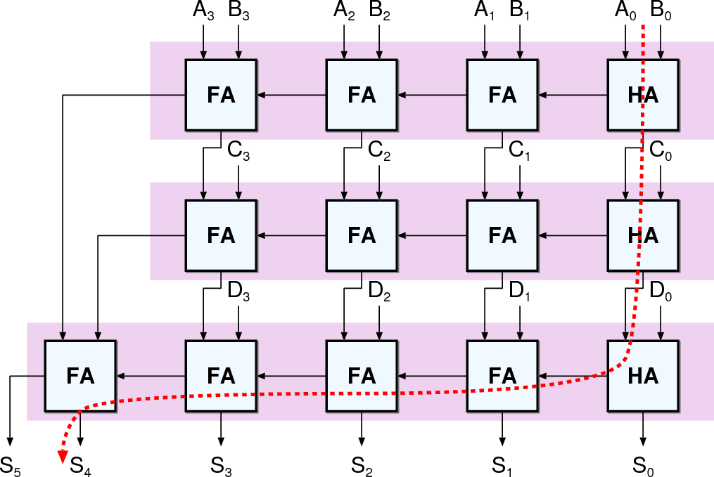
Array of Ripple Carry Adders

Slide 20
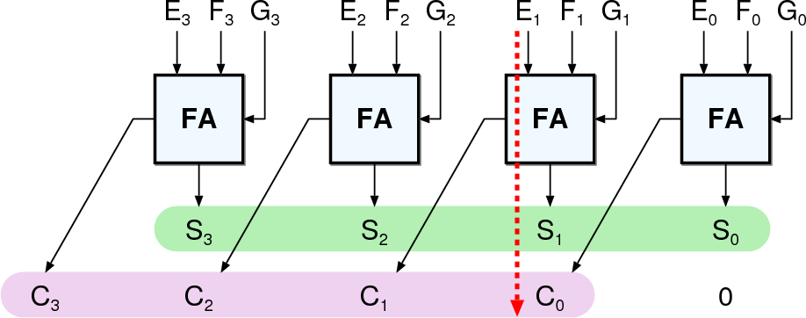
Carry Save Principle
Reduces three numbers to two with a single gate delay
C + S = E + F + G

Slide 21
Carry Save Principle
Z = D + E + F + G + H
An array of carry save adders reduce the inputs to two
A final (fast) carry propagate adder (CPA) merges the two numbers
Performance mostly
dictated by CPA

Slide 22
Multipliers
Largest common arithmetic block
Requires a lot of calculation
Has three parts
Partial Product Generation
Carry Save Tree to reduce partial products
Carry Propagate Adder to finalize the addition
Adder performance (once again) is important
Many optimization alternatives

Slide 23
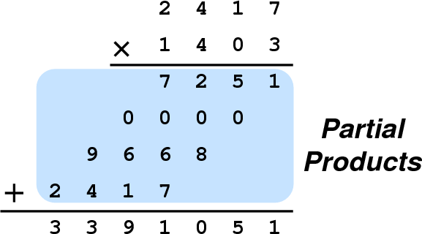
Decimal Multiplication

Slide 24




Binary Multiplication

Slide 25
For n-bit Multiplier m-bit Multiplicand
Generate Partial Products
For each bit of the multiplier the partial product is either
when ‘0’: all zeroes
when ‘1’: the multiplicand achieved easily by AND gates
Reduce Partial Products
This is the job of a carry save adder
Generate the Result (n + m bits)
This is a large, fast Carry Propagate Adder

Slide 26
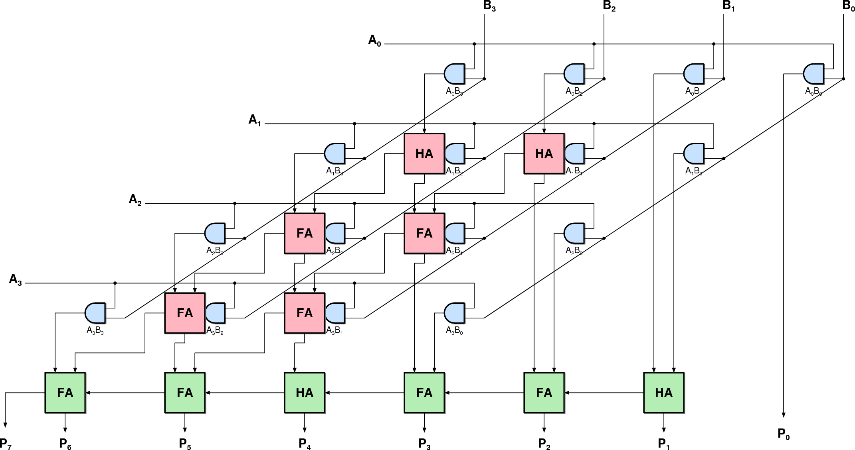
Parallel Multiplier

Slide 27
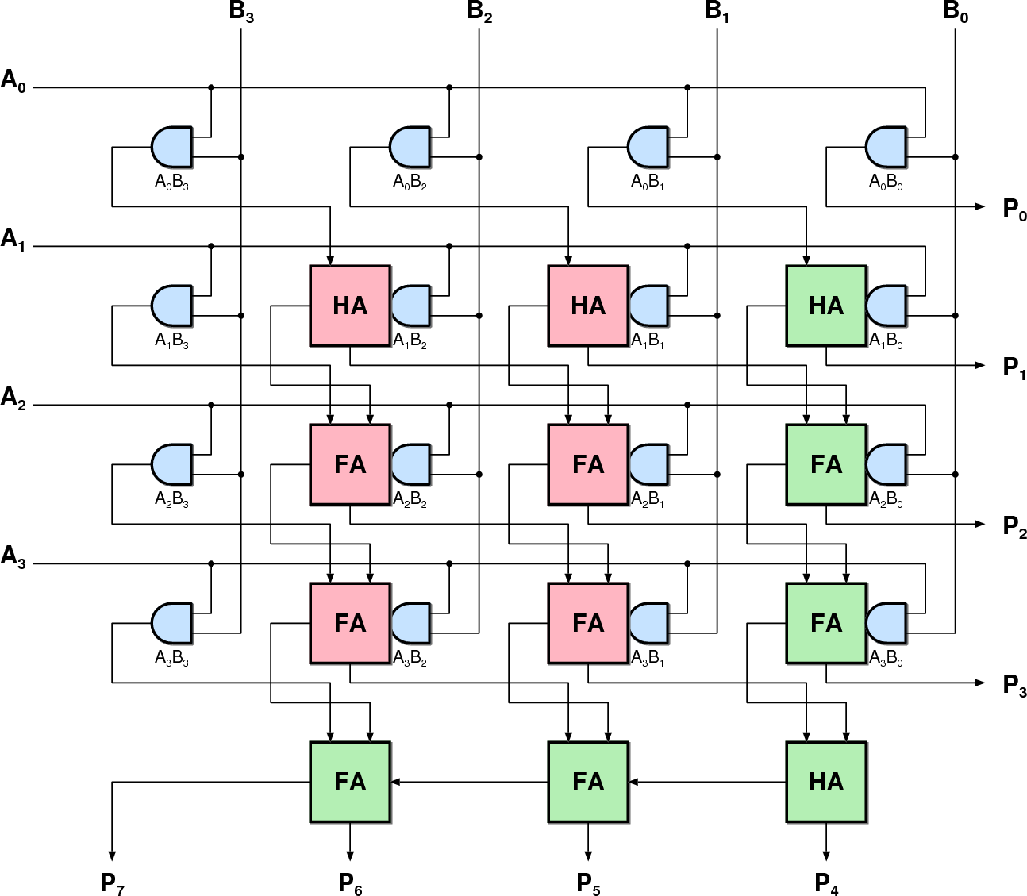
Parallel Multiplier

Slide 28
Operations Based on Adders
Several well-known arithmetic operation are based on adders:
Negator
Incrementer
Subtracter
Adder Subtracter
Comparator

Slide 29

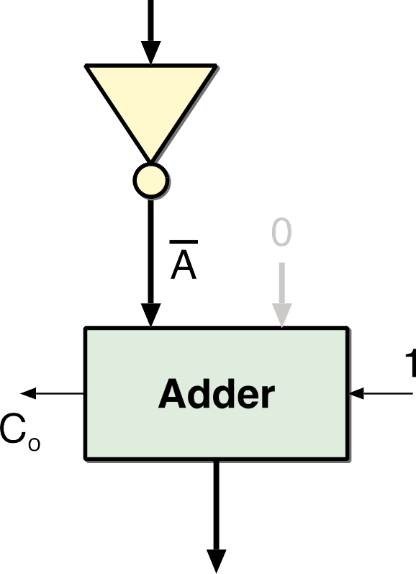
Negating Two’s Complement Numbers
To negate a two’s complement number
-A = A + 1
All bits are inverted
One is added to the result
Can be realized easily by an adder.
B input is optimized away

Slide 30
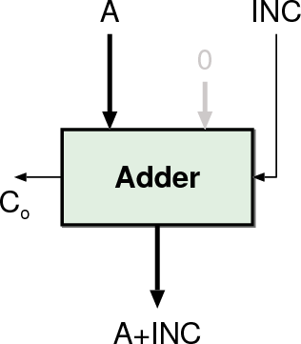
Incrementer
B input is zero
Carry In (C_{in}) of the adder can be used as the Increment (Inc) input
Decrementer similar in
principle

Slide 31
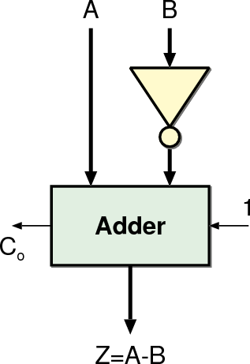
Subtracter
B input is inverted
C_{in} of the adder is used to
complement B

Slide 32
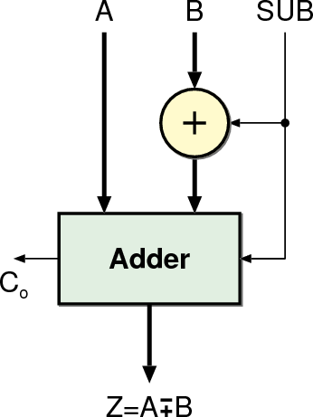
Subtracter
B input is inverted
C_{in} of the adder is used to
complement B
It can be made programmable so that both additions and subtractions can be performed at the same time

Slide 33
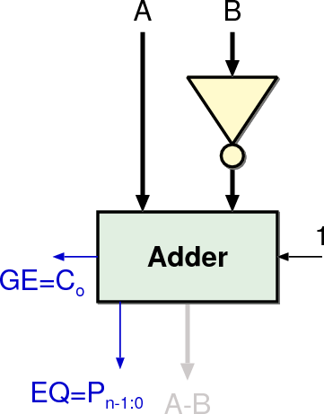
Comparator
Based on a Subtractor
(A | = | B) | = | EQ
(A | != | B) | = | EQ
(A | > | B) | = | GE |  | EQ
(A | >= | B) | = | GE
(A | < | B) | = | GE
(A | <= | B) | = | GE |  | + EQ

Slide 34
Functions Realized Without Adders
Not all arithmetic functions are realized by using adders
Shift / Rotate Units
Binary Logic functions are also used by processors
AND
OR
XOR
NOT
These are implemented very easily

Slide 35
Shifters
Logical shifter: shifts value to left or right and fills empty spaces with 0’s
Ex: 11001 >> 2 = ??
Ex: 11001 << 2 = ??
Arithmetic shifter: same as logical shifter, but on right shift, fills empty spaces with the old most significant bit (msb).
Ex: 11001 >>> 2 = ??
Ex: 11001 <<< 2 = ??
Rotator: rotates bits in a circle, such that bits shifted off one
end are shifted into the other end
Ex: 11001 ROR 2 = ??
Ex: 11001 ROL 2 = ??

Slide 36
Shifters
Logical shifter: shifts value to left or right and fills empty spaces with 0’s
Ex: 11001 >> 2 = 00110
Ex: 11001 << 2 = 00100
Arithmetic shifter: same as logical shifter, but on right shift, fills empty spaces with the old most significant bit (msb).
Ex: 11001 >>> 2 = 11110
Ex: 11001 <<< 2 = 00100
Rotator: rotates bits in a circle, such that bits shifted off one
end are shifted into the other end
Ex: 11001 ROR 2 = 01110
Ex: 11001 ROL 2 = 00111

Slide 37
Shifter Design
A₃ A₂ A₁ A₀ shamt_{1:0}
2
00
01
^{S}1:0
Y₃
10
11
shamt
00
^{S}1:0
1:0
01
Y
2
10
2
11
A
4
>>
4
Y
3:0
3:0
00 _{S}
01
1:0
Y₁
10
11
00
01
^{S}1:0
Y₀
10
11

Slide 38
Shifters as Multipliers and Dividers
A left shift by N bits multiplies a number by 2^{N}
Ex: 00001 << 2 | = 00100 | (1 ×
Ex: 11101 << 2 | = 10100 | (-3 ×
₂2
= 4)
₂2
= -12)
The arithmetic right shift by N divides a number by 2^{N}
Ex: 01000 >>> 2 = 00010
Ex: 10000 >>> 2 = 11100
(8 ÷ 2² = 2)
(-16 ÷ 2² = -4)

Slide 39
Other Functions
We have covered 90% of the arithmetic functions commonly used in a CPU
Division
Dedicated architectures not very common
Mostly implemented by existing hardware (multipliers, subtractors
comparators) iteratively
Exponential, Logarithmic, Trigonometric Functions
Dedicated hardware (less common)
Numerical approximations:
exp(x) = 1 + x²/2! + x³/3! + …
Look-up tables (more common)

Slide 40
Arithmetic Logic Unit
The reason why we study digital circuits:
the part of the CPU that does something (other than copying data)
Defines the basic operations that the CPU can perform directly
Other functions can be realized using the existing ones iteratively. (i.e. multiplication can be realized by shifting and adding)
Mostly, a collection of resources that work in parallel.
Depending on the operation one of the outputs is selected

Slide 41
Example: Arithmetic Logic Unit (ALU), pg243
^{F}2:0 | Function
000 | A & B
001 | A | B
010 | A + B
011 | not used
100 | A & ~B
101 | A | ~B
110 | A - B
111 | SLT
A
B
N
N
ALU
₃ F
N
Y

Slide 42


Example: ALU Design
^{F}2:0 | Function
000 | A & B
001 | A | B
010 | A + B
011 | not used
100 | A & ~B
101 | A | ~B
110 | A - B
111 | SLT
A B
N N
N
0
1
F₂
N
^{C}out
+
[N-1] S
Zero Extend 3
N
N
1
N
N
2
0
₂ F
N
Y
1:0

Slide 43
Set Less Than (SLT) Example
A
N
B
N
Configure a 32-bit ALU for the set if less than (SLT) operation. Suppose A = 25 and B = 32.
A is less than B, so we expect Y to be the 32-bit representation of 1 (0x00000001).
N
1
0
F₂
N
^{C}out
+
[N-1] S
Zero Extend
N
N
N
N
3
2
1
0
2
^{F}1:0
N
Y

Slide 44
Set Less Than (SLT) Example
A
N
B
N
Configure a 32-bit ALU for the set if less than (SLT) operation. Suppose A = 25 and B = 32.
N
A is less than B, so we expect Y to be the 32-bit representation of 1 (0x00000001).
For SLT, F_{2:0} = 111.
F2 = 1 configures the adder unit as a subtracter. So 25 - 32 = -7.
The two’s complement representation of
-7 has a 1 in the most significant bit, so S₃₁ = 1.
With F_{1:0} = 11, the final multiplexer selects
1
0
F₂
N
^{C}out
+
[N-1] S
Zero Extend
N
N
N
N
3
2
1
0
2
^{F}1:0
N
Y
Y = S₃₁ (zero extended) = 0x00000001
43

Slide 45
What Did We Learn?
How can we add, subtract, multiply binary numbers
What other circuits depend on adders
Subtracter
Incrementer
Comparator
Important part of Multiplier
Other functions (shifting)
How is an Arithmetic Logic Unit constructed
44

Slide 46
References
Text Books:
Computer System Architecture M. M. Mano:, 3rd ed., Prentice Hall of India, New Delhi, 1993.
Computer Organization and Design: The Hardware/Software Interface, David A. Patterson and John L. Hennessy.
Computer Organization and Embedded Systems, Carl Hamacher.

Slide 47
Please Send Your Queries on:
e-Mail: jayashree.e15737@cumail.in

